Slide 1
Herald!
By: Connor Pike and Jacob Holbrook

Slide 2
Team Members
Connor Pike
I am a 3rd year in the Computer engineering program at the University of Cincinnati. I have experience in Web App development, C#, C++, Javascript, HTML, XML and XAML. Through the co-op program I have worked for about a year as a software developer.
Jacob Holbrook
I am in my third year at University of Cincinnati in Computer Engineering. I’ve worked with Python, C++, PHP, HTML, MySQL, C#, and others.

Slide 3


What is Herald!?
System Metaphor:
Sends your current estimated time of arrival (ETA) to your destination via SMS.
Herald! Periodically checks Google maps for the estimated travel time to the destination and automatically sends a text message with this information to the chosen recipient

Slide 4
What is the purpose of Herald!?
Herald! Will allow the user to coordinate their travel more easily
Giving up-to-date arrival estimations without the need to text and drive
Alerting the recipient when you’re nearby

Slide 5


Competitor Analysis
OnMyWay
Twist- On My Way!
User inputs their own estimated arrival time and OnMyWay builds and sends a text message
Herald! Calculates the estimated time for you offering more accurate functionality and truly hands free capability
Allows users to send updates about current travel times to friends
Does not allow you to specify when messages are being sent
Requires a Twist account

Slide 6

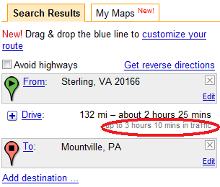
Functional Requirements
Allow the user to specify a recipient by phone number, through Contacts
Always use the users current GPS location as the start point
Allow the user to specify an End location, by address
Allow the user to specify a time interval on when to send updates
Send text messages automatically

Slide 7
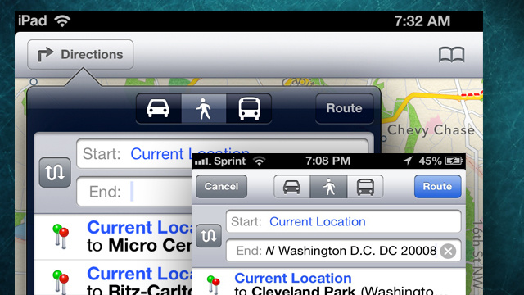
Non-Functional Requirements
Customizable text messages
Change Google maps transportation type
Multiple Recipients

Slide 8
Milestones
Initial UI
Contacts functionality
Google Maps Functionality
Specify destination
Retrieve route information
Messaging Functionality
Build message
Send message
Optimize UI
Test for ease of use
Add aesthetics
Non-Functional requirements
Change travel type
Multiple recipients
Customize message

Slide 9
Milestones- (completed in Red)
Initial UI
Contacts functionality
Google Maps Functionality
Specify destination
Retrieve route information
Messaging Functionality
Build message
Send message
Optimize UI
Test for ease of use
Add aesthetics
Non-Functional requirements
Change travel type
Multiple recipients
Customize message

Slide 10
Timeline
July 4th – Maps functionality complete
July 11th – Messaging Functionality complete
July 18th – ease of use testing complete
July 25th – UI optimized
August 1st – Multiple recipients complete
August 8th – Customizable messages and multiple travel types

Slide 11
Test Plan
Test Id | Description | Expected Results | Actual Results
001 | Precondition: contacts exist, Recipient Field is empty, A contact is selected | The contacts number populate the Recipient field
002 | Precondtion: contacts exist, Recipient Field is empty The user attempts to enter something other than a phone number in the recipient field | Nothing is entered
003 | Precondition: the Destination field is empty User enters address of destination into google maps | The address destination populates the destination field.

Slide 12
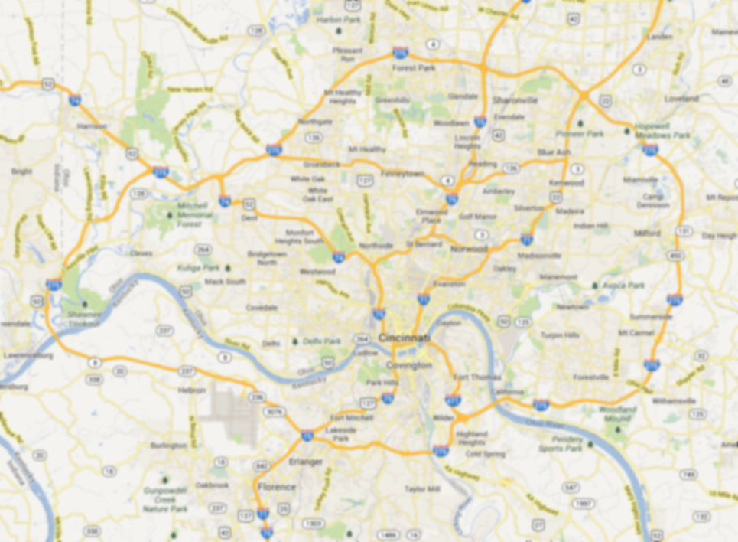
Google Maps API
Part of the Google Play Services SDK (Separate download from Android SDK)
Allows you to place and interface with maps inside your app
Requires one-time app registration to access Google’s servers

Slide 13
Setting up the Maps API
Obtain your application’s digital certificate (SHA-1 fingerprint)
Register your app on the Google APIs website
Create a new Android Key
Import the Android Key into your application
Enable Google Maps Android API v2 under “API Access” in your Google API account.
https://developers.google.com/maps/documentation/android/start

Slide 14
Using Maps in an App
The easiest way to add a map to an Activity is by adding a MapFragment to the layout xml file.
Then, in code, use the getMap() method to obtain the GoogleMap object for the MapFragment.
The GoogleMap object has methods that will allow you to customize the shown map
https://developers.google.com/maps/documentation/android/map

Slide 15
Common GoogleMap Methods
setMapType() – change the type of the map displayed – normal, satellite, hybrid, or terrain
addMarker() – add a marker on the map at a given latitude and longitude
addPolyLine(), addPolygon, addCircle() – draw on the map

Slide 16
Flyweight - Design Pattern
Purpose – Structural
Scope – Object
Motivation
Sometimes, programs need multiple objects that have some similarities, This can cause a large memory cost
Intent
Use sharing to have a large number of objects that share an internal state with the rest varying

Slide 17
Flyweight - Participants
Flyweight
Declares an interface through which flyweights can receive and an extrinsic state
ConcreteFlyweight
Implements Flyweight interface and stores shared internal state
FlyweightFactory
Creates and manages flyweight objects
Maintains a pool of flyweights, returns an object from the pool if it is already created and adds one if it is new
Client
Computes and maintains extrinsic state

Slide 18
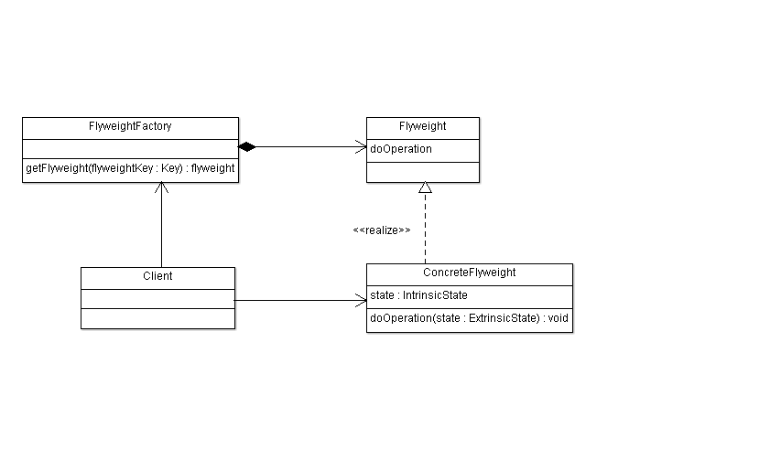
Flyweight – Class Diagram

Slide 19
Flyweight - Implementation
Client calls factory to get flyweight object
Factory checks pool to determine if object exists
If so factor returns object
Otherwise factory creates object adds it to the pool and returns it
Flyweight maintains shared internal state and provides methods to manipulate varying external state

Slide 20
Flyweight - Example
Text Editor
Character Object
Letter flyweight maintains Character Type and Font
Letter Client maintains location inside document

